Slide 1

City Commission
Strategic Plan Workshop
January 28, 2021
6:30 PM

Slide 2
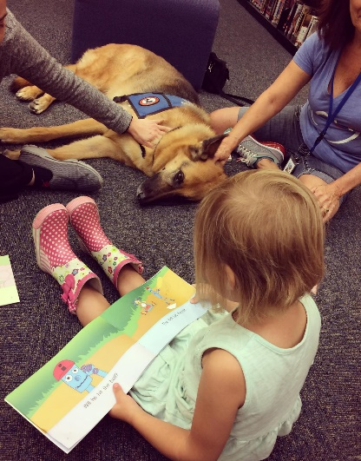
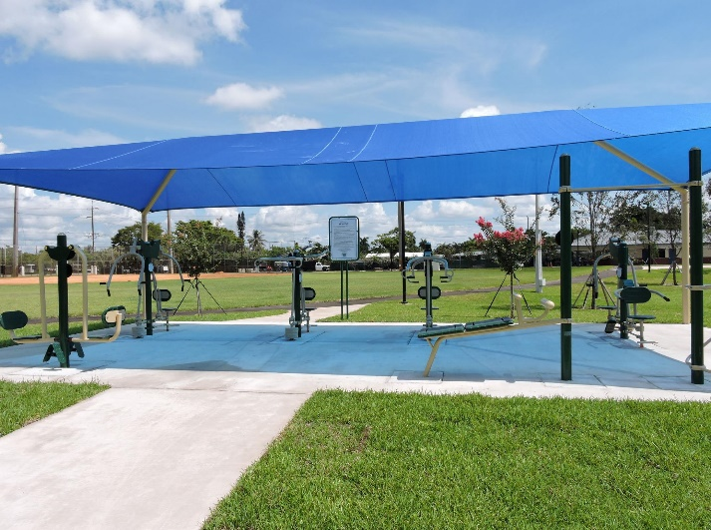
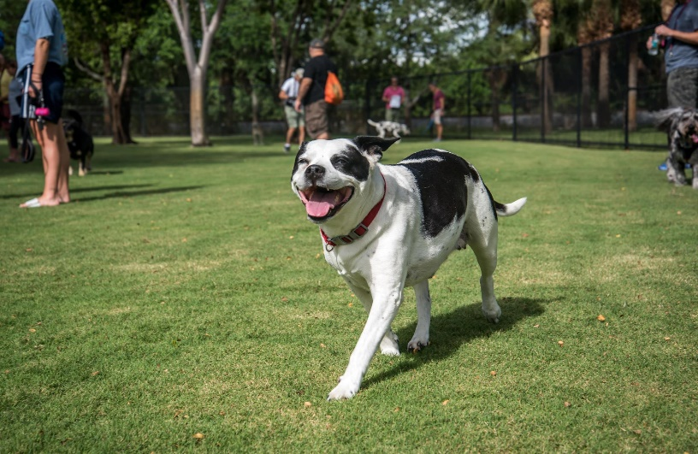
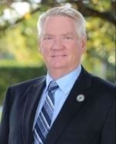
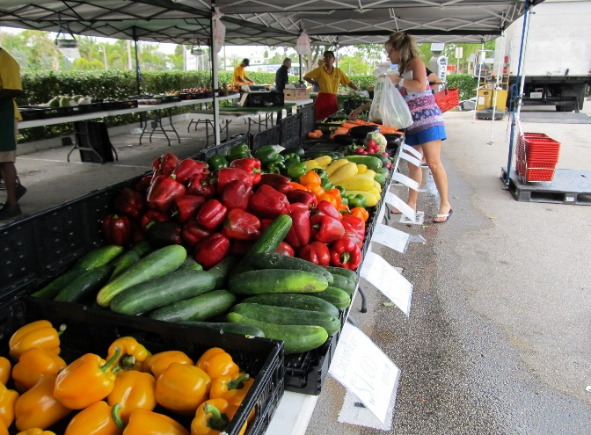
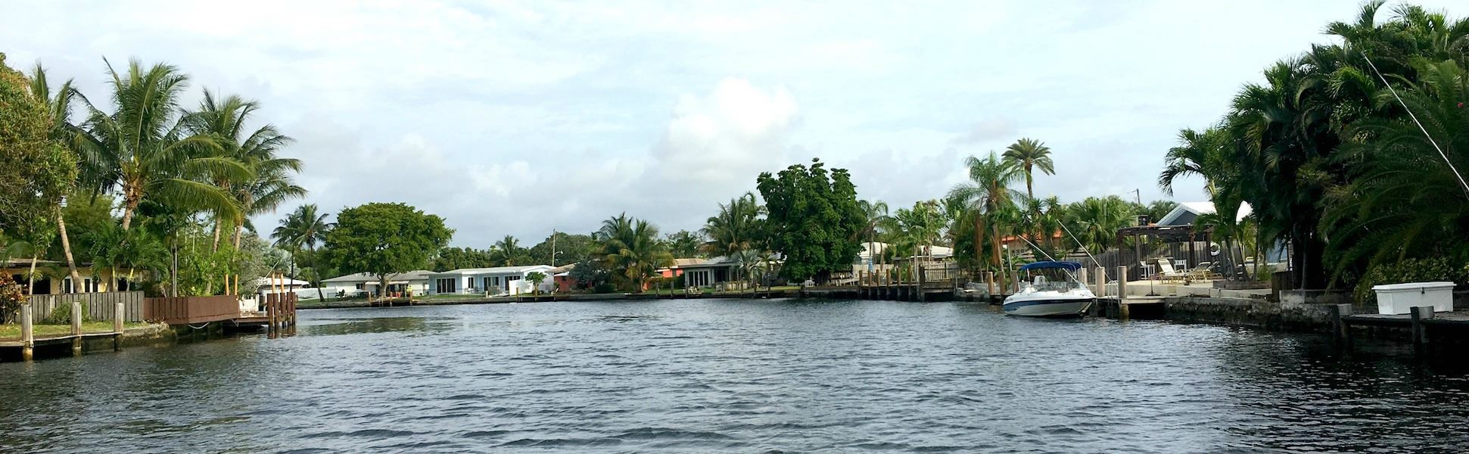
Welcome from Mayor Scott Newton

Slide 3

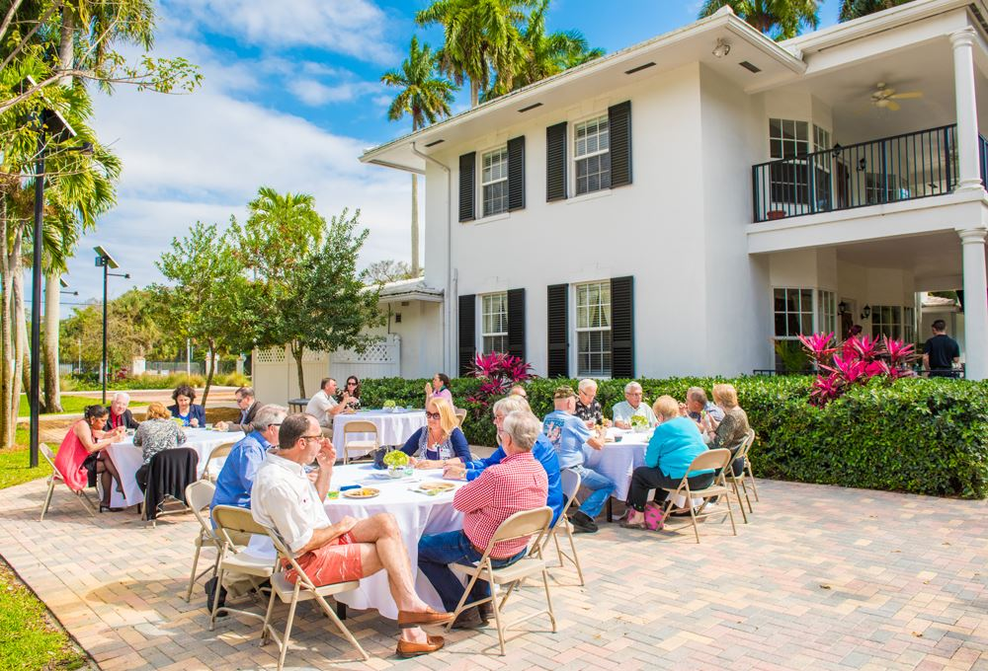
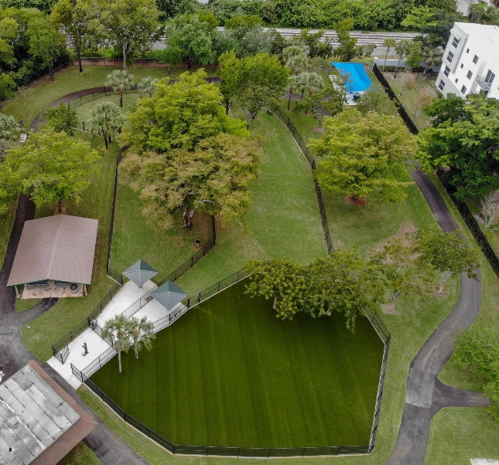
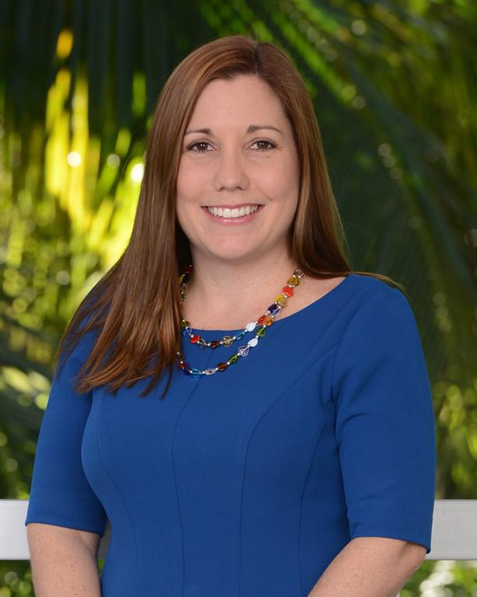
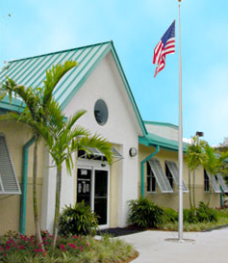
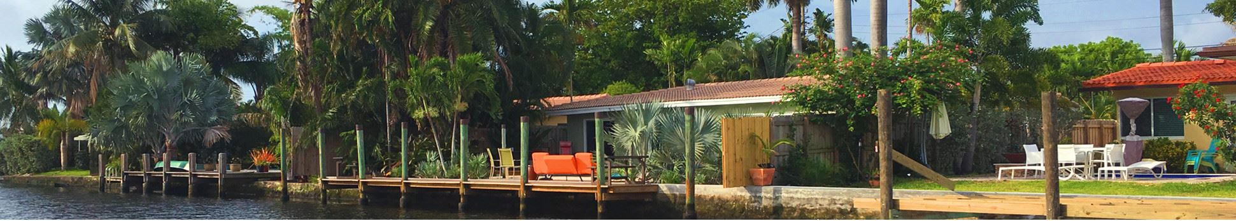
Comments from City Manager Leigh Ann Henderson

Slide 4
Workshop Objectives
Affirm the vision, mission, and core organizational values
Develop consensus priorities and goals
Identify key objectives to achieve the goals
Discuss what success looks like in 2025

Slide 5
Agenda
Review Environmental Scan and Accomplishments
Welcome and Agenda Review
Affirm Current Vision, Mission, and Review Values
Develop Consensus Priorities and Goals
Discuss Success Indicators
Review Community and Employee Survey Results

Slide 6
Commission and Staff Interviews
Conduct Community and Employee Survey
Conduct Strategic Plan Workshop with Commissioners
Prepare Strategic Plan
Commission Action on Strategic Plan
Prepare Implementation Action Plan
Develop Environmental Scan
Strategic Planning Process
Overview

Slide 7
Environmental Scan and 2015-2020 Strategic Plan Accomplishments

Slide 8

DEMOGRAPHICS
Current Population: 12,756
<1% population growth annually over a 10-year period

Slide 9
Who Is Wilton Manors?

Slide 10
Who Is Wilton Manors?

Slide 11
Who Is Wilton Manors?
Notes:
Wilton Manors is a small-sized, majority White City with an unusually high ratio of males to females, 2/1, in the City and the median age of residents is 51.
Approximately 43% of the population is age 55 or older
Median household income exceeds that of Florida and the U.S.
11% of the City’s residents live in poverty

Slide 12
HOUSING & COMMERCE
8000 Housing Units
Median Value =
$319,100
60% Owner Occupied
Approximately 50% single-family units
Most Units
older than 40 years old
Notes:
Majority of housing units are owner-occupied; however, there is a sizeable population of snowbird properties and residential units used for vacation rentals.
Housing units evenly divided between single-family homes and multi-family / mixed use properties.
Wilton Manors remains primarily an arts, entertainment, recreation, retail and food service economy.
Employment base is predominantly small to medium sized businesses.

Slide 13
Top Ten Properties – Ad Valorem Revenue
Using 6/1/20 taxable value and proposed operating millage rate of 5.9587
Owner | Reference | Assessed Value | Ad Valorem Taxes
Ascend Wilton Twenty Fourth | Metropolitan | $37,500,000 | $223,451
LG Wilton Park LLC | Gables at Wilton Park | 30,539,100 | 181,973
Clayton Wilton Tower LLC | Wilton Tower | 22,994,690 | 137,018
Marrinson Group | Marrinson - Senior Living | 18,396,080 | 109,617
2262 Wilton Dr Owner LLC | Shoppes of Wilton Plaza | 17,999,400 | 107,253
2701 North Andrews Property | Wilton House/ Palm Gardens | 15,926,830 | 94,903
Real Sub LLC | Five Points Plaza | 8,652,850 | 51,560
Moss Office Building LLC | Moss Construction | 8,396,610 | 50,033
Wilton 26 St Property LLC | Holy Mackerel Plaza | 8,014,770 | 47,758
Carl S Williams Trust | OPB Publix Plaza & 7-11 | 7,508,180 | 44,739
Totals |  | $175,928,510 | $1,048,305

Slide 14
Sampling of Wilton Manors Large Employers
Employer Name | # of Employees | Address
Marrinson Group | 302 | 1601 NE 26 Street
Wilton Manors Rehabilitation Center | 171 | 2675 N Andrews Avenue
City of Wilton Manors | 140 | 2020 Wilton Drive
KID Inc. | 135 | 819 NE 26 Street
Moss Construction | 132 | 2101 N Andrews Avenue
Publix – Oakland Park Blvd. | 125 | 100 W Oakland Park Blvd
Publix – Five Points | 100 | 2633 N Dixie Highway
Wilton Manors Elementary (BCSB) | 87 | 2401 NE 3 Avenue
Pace Center for Girls - Broward | 53 | 2225 N Andrews Avenue
CSL Plasma – Wilton Manors | 44 | 2825 N Andrews Avenue
Somerset Academy | 35 | 225 NW 29 Street
United National Consumer Suppliers (UNCS) | 23 | 1501 NE 26 Street

Slide 16
Notes:
City is currently “built out” with much attention being given to responsible and forward-thinking development and redevelopment.
Emphasis on strengthening commercial corridors beyond Wilton Drive and diversification of businesses
Future land use plans consolidate land use types and incorporate more commercial designations and a TOC.

Slide 17
Revenues and Expenditures

Slide 18
Summary Sources of Revenue
Since 2015, the City has increased its revenues by 22%, or $3,094,680

Slide 19
Adjusted Taxable Values For
FY 2014-2015 to FY 2019-2020
Total adjusted taxable values for Wilton Manors have increased steadily between 2014 and 2019

Slide 20
Summary of Outstanding Debt
Notes:
Heavy reliance on ad valorem taxes for revenue, approximately 51% of all revenues
From 2014-2019 taxable values have increased more than 33%
Bulk of remaining revenue from fees, special assessments, utility taxes
Personnel costs account for largest category of expenditures
Funds balances in all areas have remained stable and acceptable
Current debts on track to be satisfied by 2028.

Slide 21
Public Safety

Slide 22
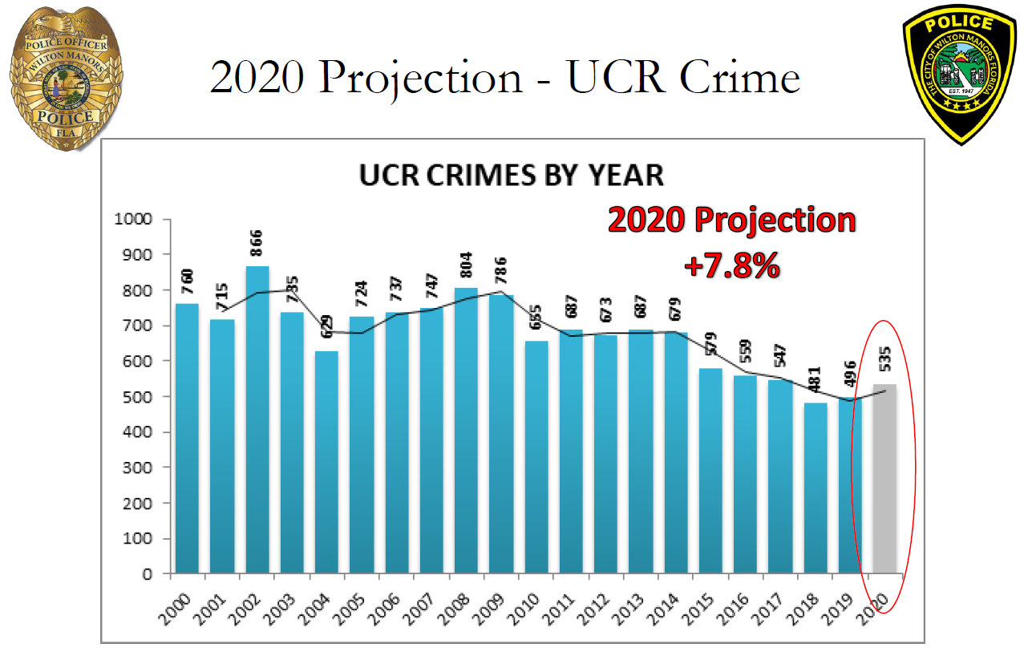
Public Safety
Notes:
Emphasis on community policing and engaging with residents
Crime has been trending downward and largely non-violent. Majority of crimes are related to theft.
As the prevalence of violence at large-scale events increases worldwide, City is presented with a fiscal and personnel challenge in providing security for attendees at such events.

Slide 23
2015 to 2020 Strategic Plan
Achievement Highlights

Slide 24
Priority Area A - Proactive Public Safety
Goal 1: Utilize technology to reduce crime and increase awareness about crime in the City.
Goal 2: Continuously develop capacity of City employees to address public safety.
Goal 3: Provide emergency management to ensure public safety in the City.
Goal 4: Provide fire safety and emergency medical services to ensure public safety in the City.
Goal 5: Utilize Code Compliance to support and enhance public safety.
Goal 6: Provide safe roadways for all users.
Implemented technologies for direct messaging and public safety efficiencies, including Safer Watch, CodeRED, WatchGuard, and Community Crime Mapping
Reduced UCR crime four out of five years, a 14.3% reduction in these crimes when comparing 2015 to 2019 (579 v. 496).
Achieved reaccreditation of the Wilton Manors Police Department by the Commission for Florida Law Enforcement Accreditation for the third consecutive cycle in 2016, and again in 2019
Developed a Master Security Plan for all public facilities
Renegotiated fire services with City of Ft. Lauderdale
Created and executed several Code Compliance Action Plans that addressed property maintenance and other “Quality of Life” issues to support the continued increase in property values
Implemented of Cannabis civil citation program
Marine Law Enforcement Grant (MLEG) every year totaling over $155,000to support the WMPD Marine Unit.
Formed Active Crime Enforcement Unit for specialized investigations of emerging crime trends
Completed structural upgrades to Fire Station 16

Slide 25
Priority Area B – Sound Governance
Goal 1: Operate in a fair and transparent manner.
Established the Strategic Public Relations and Marketing Plan, increasing public investment and two-way communication between the City and its stakeholders
Goal 2: Provide excellent services to the community.
Goal 3: Promote and maintain financial stability and integrity.
Goal 4: Ensure government employees are qualified and competent.
Goal 5: Support and make use of community resources.
Created and implemented the Island City University, resulting in 4 separate graduating classes and more than 70 residents participating
Created an IT Department, infrastructure assessment and updating of IT system
Refinanced City Hall loan debt
Implemented Water rate study
Completed indirect cost rate study
Achieved clean audits for all five fiscal years
Completed all staff training on ethics and diversity & inclusion
Continued training of police on cultural competency and implicit bias
Maintained fund balance of between 15% and 20% each fiscal year
Mitigated mid-year economic downturn that reduced the City’s annual revenue by 6.57% through budget cuts
Streamlined board application process and created policies and procedures
Converted permanent records from paper to electronic

Slide 26
Priority Area C – Strategic Growth
Executed a City Urban Land Institute workshop during the urban form assessment
Goal 2: Ensure that the City’s properties and infrastructure meet the present and future needs of the City.
Goal 3: Develop and use a Master Economic Development Plan.
Updated Urban Form and Density regulations
Prepared a Future Land Use map
Narrowed Wilton Drive
Reconstructed and repurposed Mickel Park
Completed Water Wastewater and Stormwater Master Plan
Established Economic Development Strategic Plan and hired an Economic Development Manager
Updated the Code of Ordinances
Established the Wilton Drive Improvement District
Completed Andrews Avenue and Oakland Park Blvd rezoning study
Established an affordable housing trust fund, funding first-time homebuyer program and contribution to the Residences at Equality Park
Repurposed Colohatchee Park and added a dog park
Assessed City Hall property for redevelopment
Goal 1: Utilize development standards to maintain small-town feel in the City.

Slide 27
Priority Area D – Innovating and Adapting for the Future
Goal 1: Explore the possibilities of environmentally sustainable City policies within the parameters of the established budget.
Goal 2: Encourage environmentally sustainable practices.
Goal 3: Utilize relationships with other agencies to address future regional issues.
Created the Wilton Manors/Oakland Park Joint Climate Action Plan
Executed baseline Community Greenhouse Gas Inventory
Implemented vacation rental identification software
Implemented and expanded online services for building permits, business tax receipts, rentals with payment option and implemented Leisure Services software for online childcare and facility rentals payments
Implemented meeting technology/software, which allowed for virtual and hybrid commission meetings during the pandemic.
As a result of the pandemic, Created a safe, in-person childcare/education program for children of residents working outside of the home during the pandemic
Instituted curbside delivery services and virtual access to library patrons
Added two hybrid vehicles to police fleet for a total of six
Added hazardous household waste pick-up for residents
Added two electric car charging stations on City properties
Participated in the Broward County PACE Center for Girls Program
Completed all staff training on Climate Change Awareness
Secured funding approval for five city projects through the Broward County Transportation Surtax program

Slide 28
Wrap Up Slide
How do we:
  Maintain small town sensibility and sense of community?
  Diversify demographically?
  Increase number and variety of housing stock?
  Grow the ad valorem tax base?
  Diversify economically?
  Grow the Tree Canopy?
  Increase park land and increase walkability?

Slide 29
DATA SOURCES
The Census Bureau
  Vintage 2019 Population Estimates
  2014-2018 American Community Survey 5 Year Estimates
Wilton Manors FL 2019-2020 Adopted Budget
Wilton Manors Land Use Plan
Wilton Manors Police Department
Florida Department of Law Enforcement 2019 Crime in
Florida, Annual 2018 Florida uniform crime report

Slide 30
Review Survey Results

Slide 31
Experience Contacting the City
Answer Choices | Very Satisfied/ Satisfied | Neither Satisfied nor Dissatisfied | Dissatisfied/ Very Dissatisfied
Courteousness of employees | 81% | 15% | 4%
The professionalism of employees | 77% | 16% | 7%
The knowledge of employees | 77% | 17% | 6%
Access to employees | 77% | 12% | 11%
Timeliness of response | 76% | 14% | 10%
How well your question/request was answered | 74% | 13% | 13%

Slide 32
Strengths and Opportunities
Summary of Strengths
Location
A value of inclusiveness
Committed volunteers
Parks and open space
Leisure services programs and events
Accessibility of city staff
Small-town feel
Professional city staff
Summary of Opportunities
Upgrade sewer and water systems
Invest in pedestrian and bicycle infrastructure
Diversify business types on Wilton Drive
Enhance the city’s climate resiliency
Enhance economic development along major corridors (Andrews Ave, Oakland Park Boulevard, 26th Street)
Increase affordable housing

Slide 33
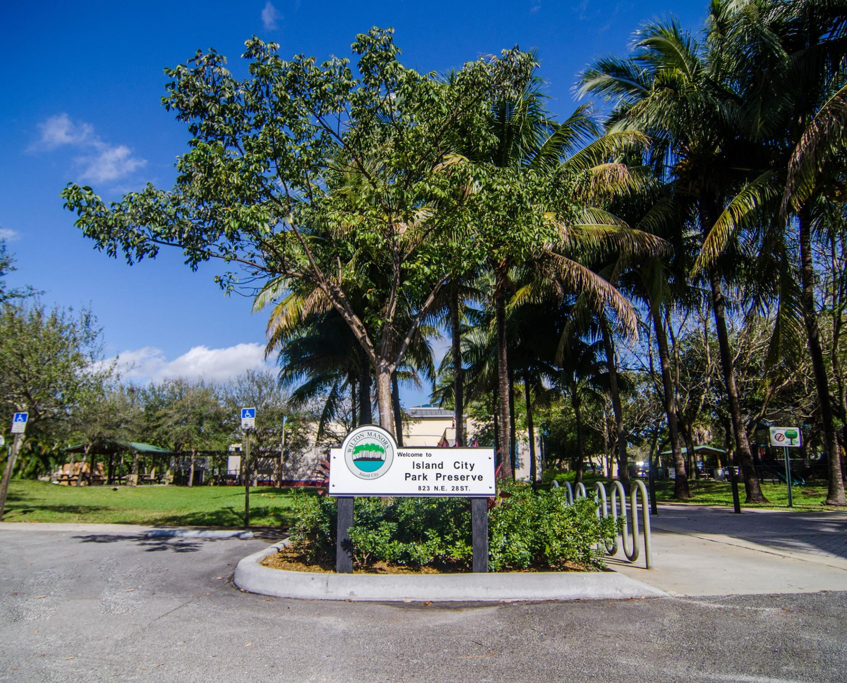
Feedback on Vision and Mission
69% of community respondents and 77% of staff respondents believe the vision statement should not be changed
81% of community survey respondents and 92% of employee respondents indicated the mission statement should not be changed

Slide 34
Vision, Mission and Values

Slide 35
Vision Statement
A vision statement articulates the desired future of the organization.
Current Wilton Manors Vision
The City of Wilton Manors government strives to take effective actions to ensure quality services, while sustaining a diverse culture and small-town charm.
Do you have suggested changes and/or additions to the current vision for Wilton Manors?

Slide 36
Mission Statement
The mission states the purpose of the organization
Current Wilton Manors Mission
The City of Wilton Manors government is committed to improving the quality of life in our community by delivering valued and fiscally-sound services with integrity and respect to the residents, businesses, and guests of our City.
Are there suggested changes to the mission statement?

Slide 37
Proposed Organizational Values
Values state the behaviors and intentions of decision-makers and staff in carrying out policy and programs and delivering services to the public
Honesty
Integrity
Respect
Transparency
Diversity and Inclusion
Fiscal Responsibility
Customer-Friendly Service
Fairness

Slide 38
Proposed Goals
and
Objectives

Slide 39

Proposed Goals
A. Economic Development
B. Quality of Life and Livability
C. Efficient and High Performing Government
D. Fiscal Responsibility
E. Environmental Sustainability
Are any significant
goals missing?
Are there goals you would remove or rephrase?
For each goal, what key outcomes should be achieved?

Slide 40
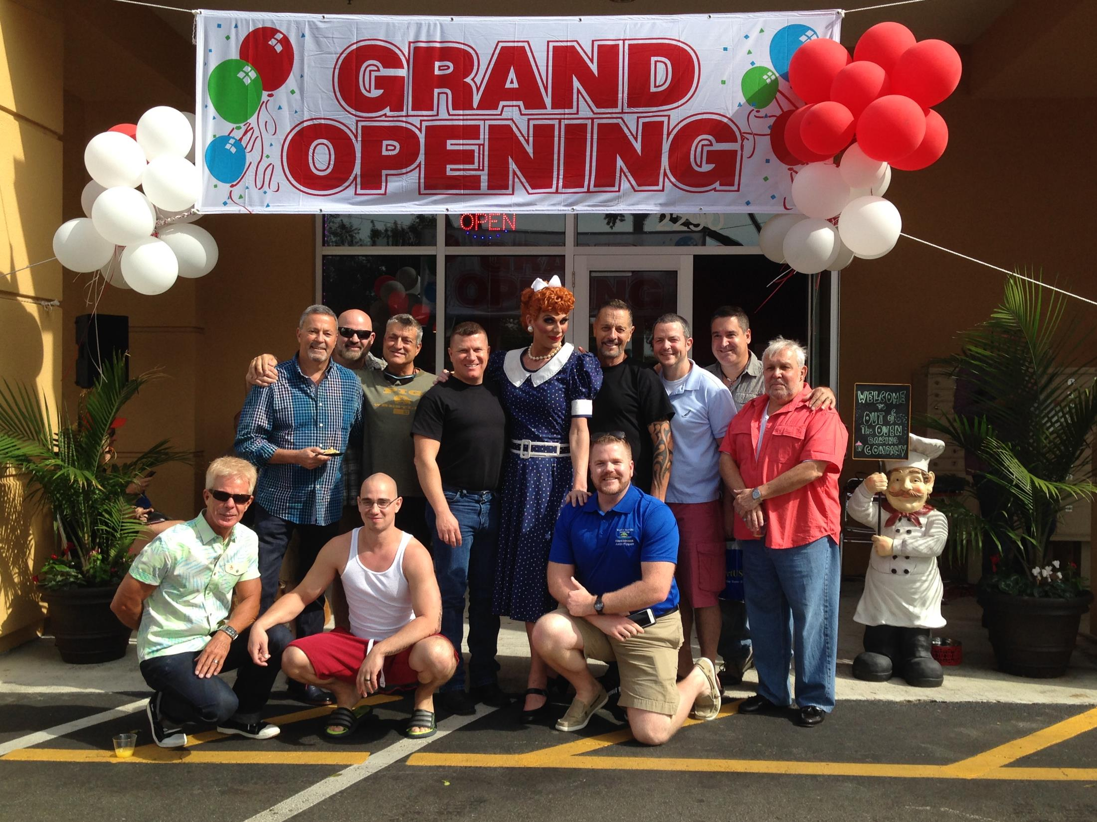
Goal A. Economic Development
Key Objectives
Promote Business Retention and Attraction
Increase Density to Accommodate Mixed-Use Development (residential/commercial)
Ensure Application of “Smart” Growth Policies
Promote Wilton Manors as a Tourist Destination

Slide 41
?
Discussion
How would you change
or revise the key objectives to ensure outcomes are achieved?

Slide 42
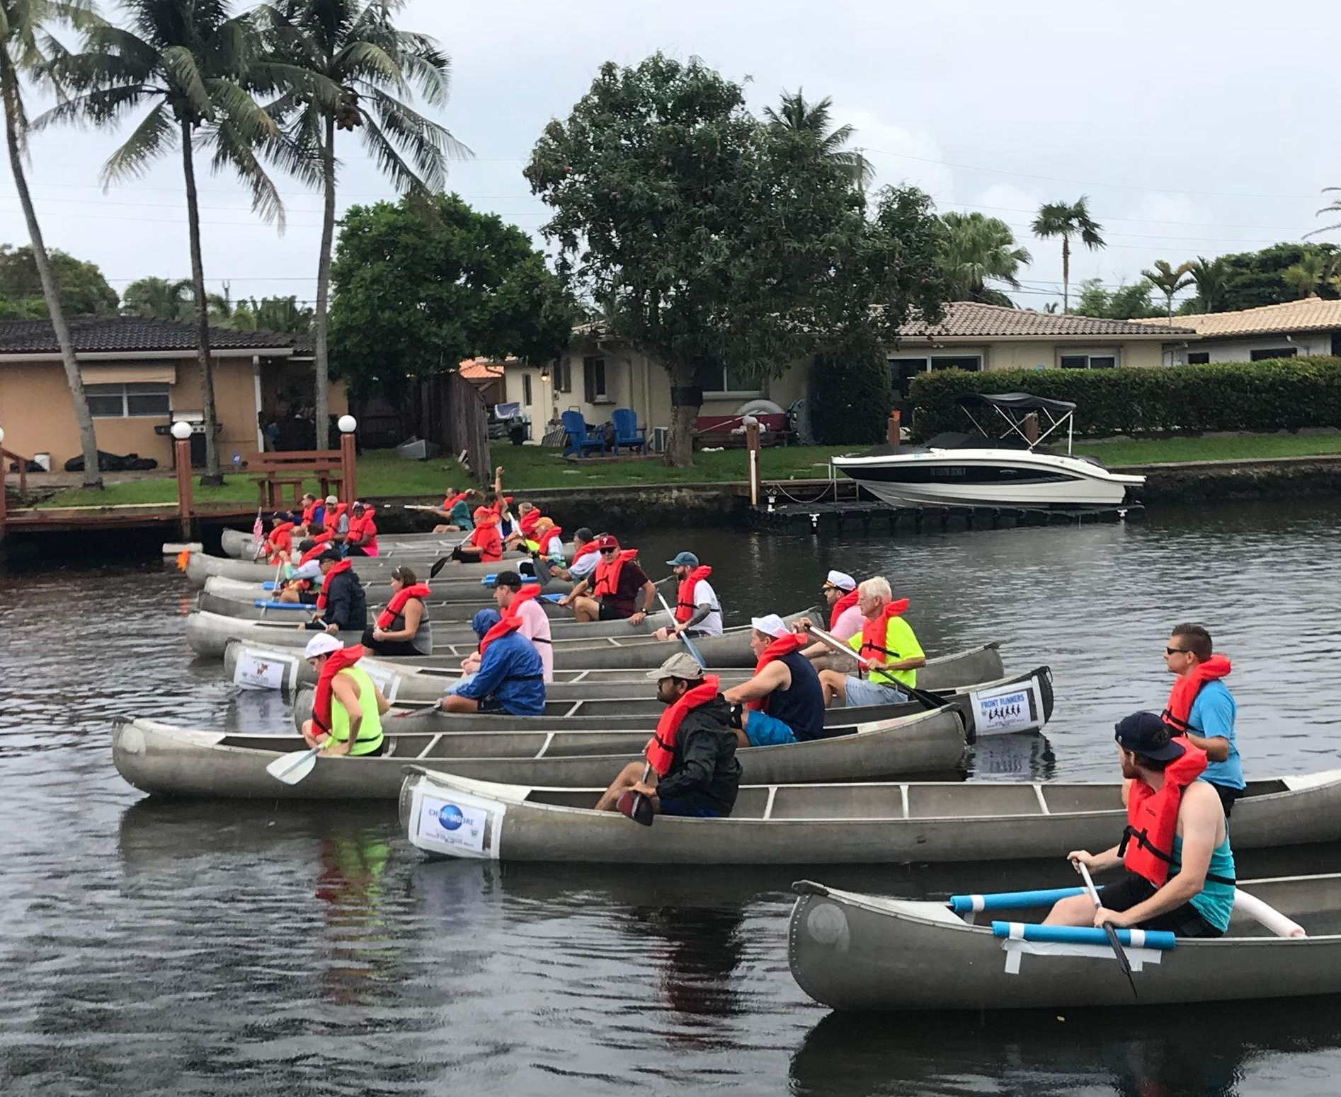
Goal B. Quality of Life and Livability
Key Objectives
Improve Pedestrian Infrastructure and Amenities
Enhance Beautification and Cleanliness of the City
Support Proactive Public Safety
Promote Recreation and Open Space

Slide 43
?
Discussion
How would you change
or revise the key objectives to ensure outcomes are achieved?

Slide 44
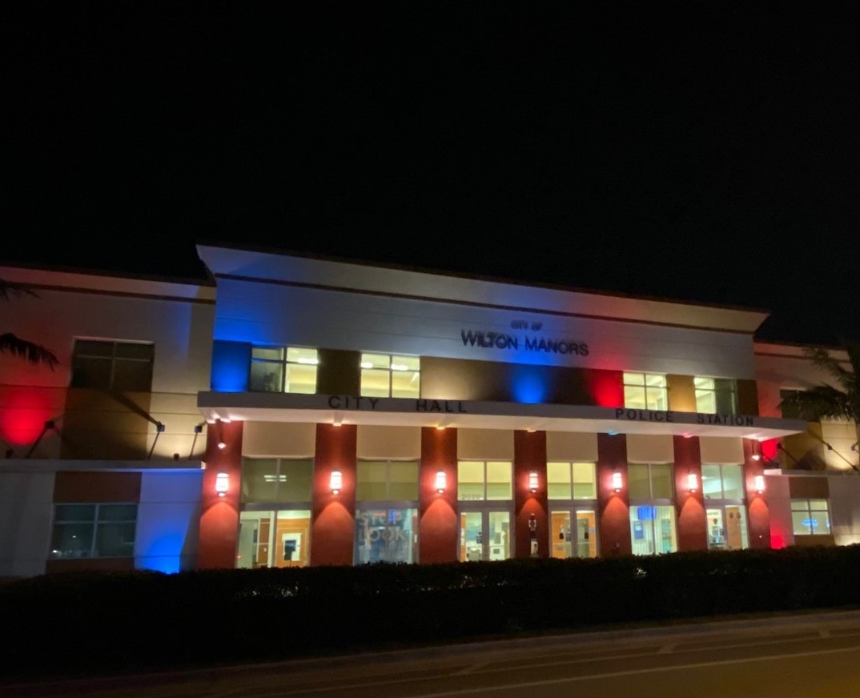
Goal C. Efficient and High Performing Government
Key Objectives
Identify City Government Operational Efficiencies and Improvements
Determine Technology Upgrades
Enhance Public Outreach
Promote Greater Diversity on Wilton Manors Boards and Commissions

Slide 45
?
Discussion
How would you change
or revise the key objectives to ensure outcomes are achieved?

Slide 46
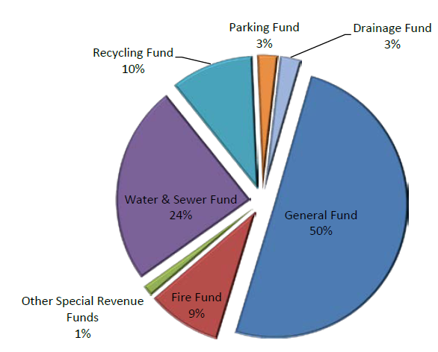
Goal D. Fiscal Responsibility
Key Objectives
Pursue Economic Sustainability (balanced revenue model)
Identify Future Funding for Major Projects
Develop a Long-Term Financial Plan

Slide 47
?
Discussion
How would you change
or revise the key objectives to ensure outcomes are achieved?

Slide 48
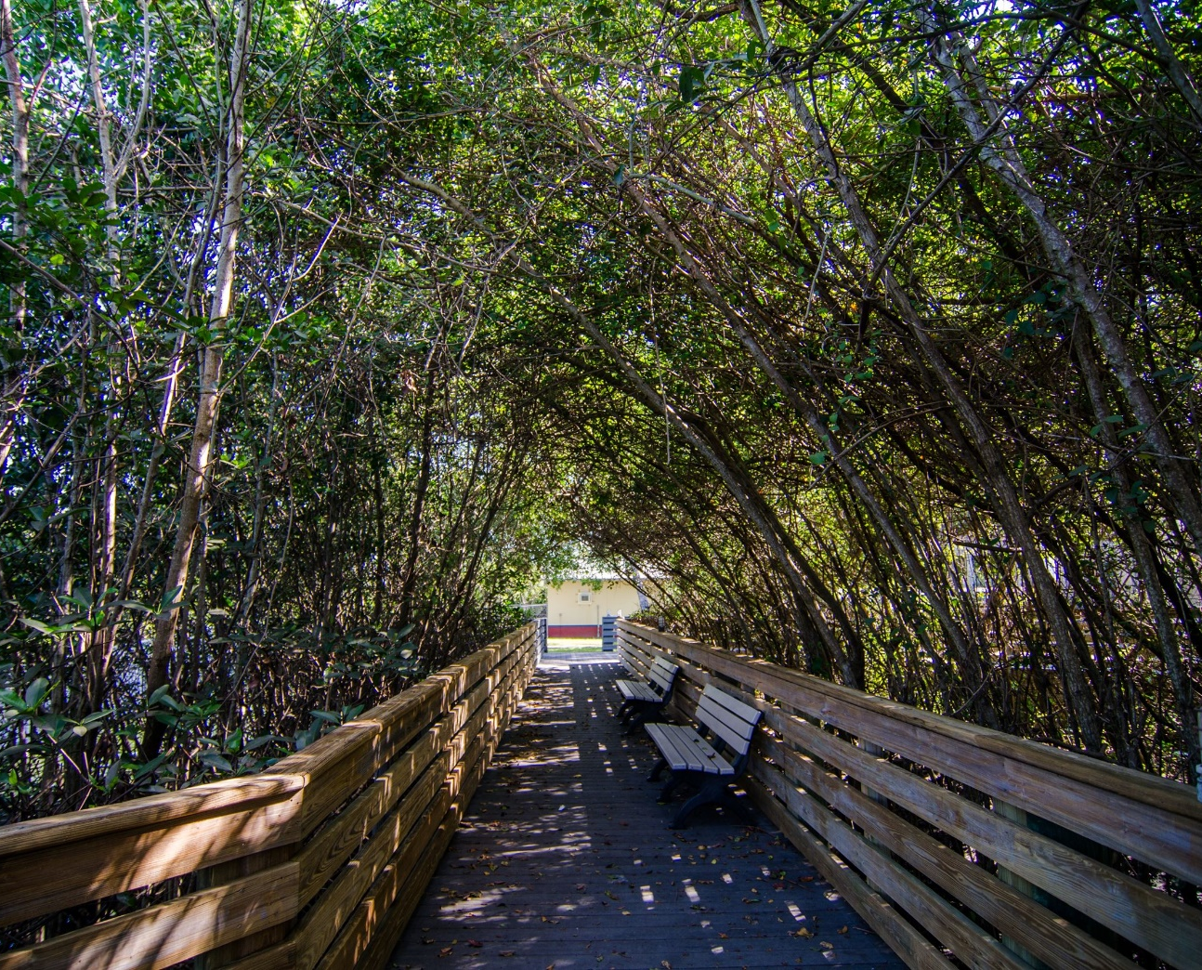
Goal E. Environmental Sustainability
Key Objectives
Improve Stormwater/ Wastewater Infrastructure
Address Climate Resiliency
Reduce the City’s Carbon Footprint

Slide 49
?
Discussion
How would you change
or revise the key objectives to ensure outcomes are achieved?

Slide 50
Wrap Up
Next Steps
Closing Comments

Slide 51
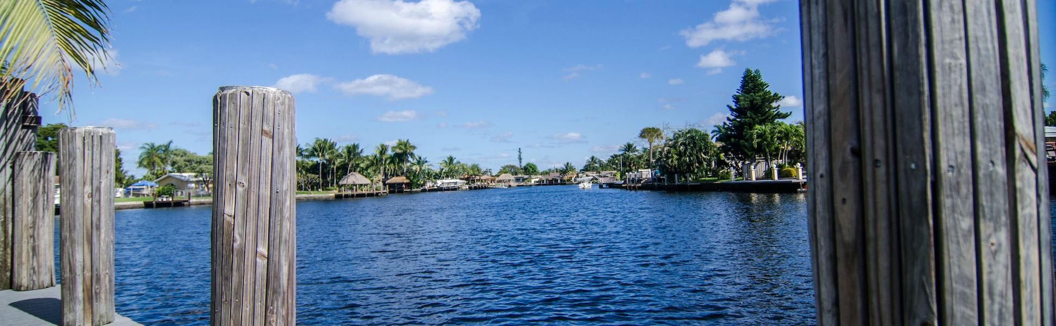
Thank you!
Jacquelyn McCray, Partner | jmccray@managementpartners.com
Sam Lieberman, Senior Manager | slieberman@managementpartners.com

