Slide 1
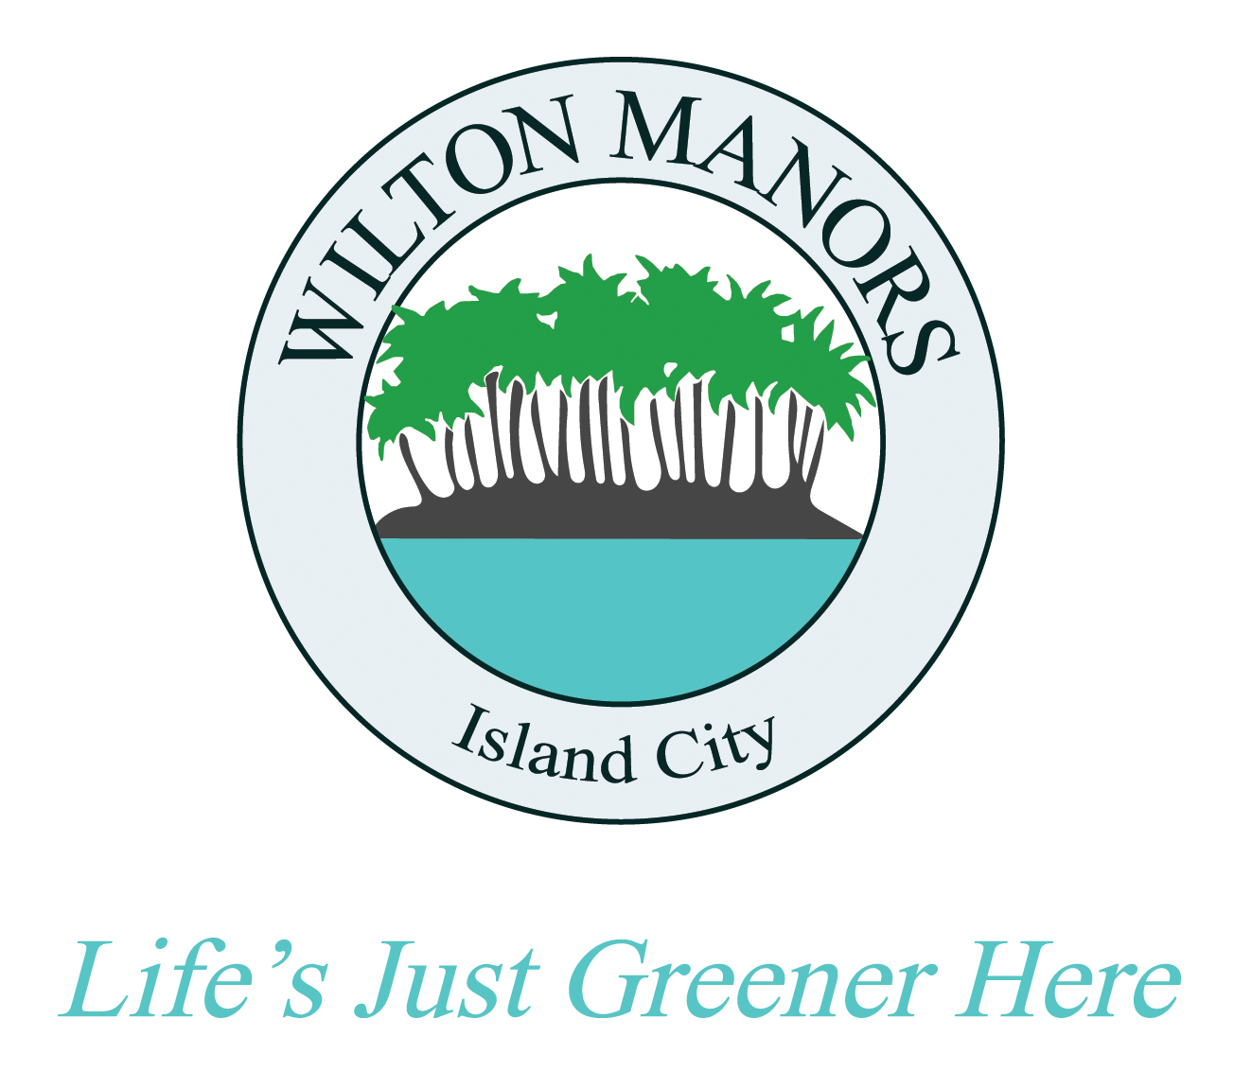
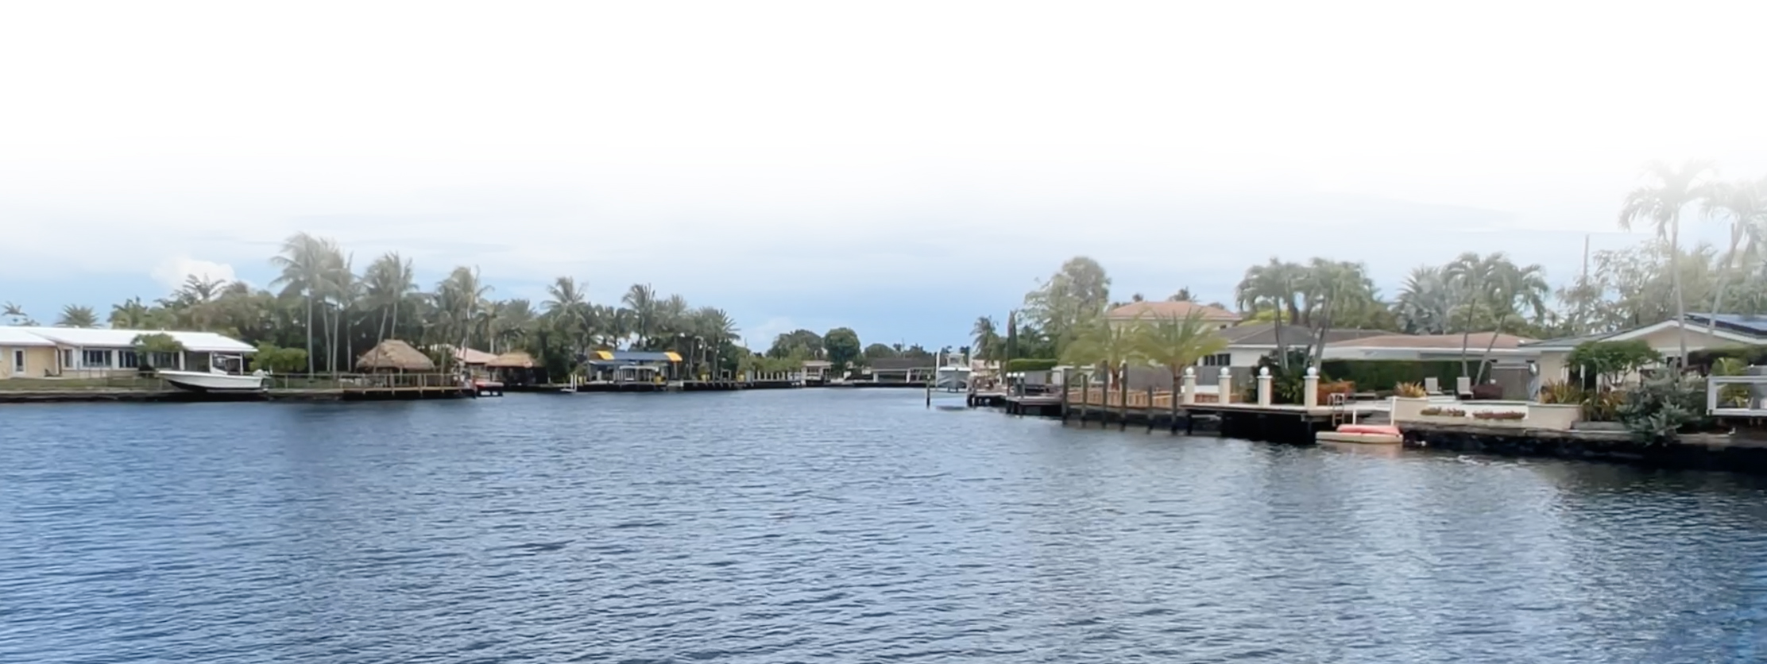
City of Wilton Manors
Sea Level Rise Vulnerability Assessment Steering Committee
Key Terminology
Here are some terms that will familiarize you with the subject matter:
Adaptive Capacity - The ability of an asset to adjust or cope in response to hazards.
Assets - The core systems, specific property classes, services, economic strengths, people/socioeconomics and infrastructure located throughout the community. Examples: schools, roadways, bridges, underground electric and water utility lines, municipal properties, residences, businesses.
Census Tract Scale - A geographic area utilized by the US Census Bureau for data collection and assessment (picture).
Climate Threats - Major hazard events or chronic disruptions that negatively impact community assets.
Exposure Mapping - Spatially analyzing where assets are in harm’s way.
Geospatial Information Software - Computer-based tools used to store, visualize, analyze and interpret geographic data. Usually portrayed as layers on a map.
Mitigation - Methods by which the severity of an impact can be reduced through technology and infrastructure. Examples of flood mitigation: planning and zoning, floodplain protection, public outreach.
Sensitivity - The range or magnitude of how much an asset may be hurt by a threat.
Social Equity - The ability for all members of the community to equally prosper through collective planning and action.
Risk - Both threat and asset characteristics used to indicate levels of probability of acclimate event and its associated impact.
Vulnerability - The output of an analysis and its evaluation of the intersection of various asset characteristics used to indicate levels of sensitivity, potential impact and adaptive capacity.
Page 1

